Slide 1
Computer Architecture
A Quantitative Approach, Sixth Edition
Chapter 1
Fundamentals of Quantitative Design and Analysis
Part 3: Benchmarking & Technology Trends
“I think it’s fair to say that personal computers have become the most empowering tool we’ve ever created. They’re tools of communication they’re tools of creativity, and they can be shaped by their user.” – Bill Gates, February 2004

Slide 2
Acknowledgements
Thanks to many sources for slide material
© 1990 Morgan Kaufmann Publishers, © 2001-present Elsevier
Computer Architecture: A Quantitative Approach by J. Hennessy & D. Patterson
© 1994 Morgan Kaufmann Publishers, © 2001-present Elsevier
Computer Organization and Design by D. Patterson & J. Hennessy
© 2002 K. Asinovic & Arvind, MIT
© 2002 J. Kubiatowicz, University of California at Berkeley
© 2006, © 2010 No Starch Press for Inside the Machine by J. Stokes
© 2007 W.-M. Hwu & D. Kirk, University of Illinois & NVIDIA
© 2007-2010 J. Owens, University of California at Davis
© 2010 CRC Press for Introduction to Concurrency in Programming Languages by M. Sottile, T. Mattson, and C. Rasmussen
© 2017, IBM POWER9 Processor Architecture by Sadasivam et al., IBM
© 2016, © 2019 POWER9 Processor User’s Manual, IBM
© The OpenPOWER Foundation

Slide 3
Outline
Benchmarks
Technology
In a power-constrained world, we can’t keep increasing performance by increasing clock speed.
Architectural Trends
Microarchitectures have historically increased performance by increasing ILP and pipeline depth. Today, we can’t keep increasing performance at historical levels by these methods.
Bandwidth vs. Latency

Slide 4
What makes a good benchmark?
What do you want to avoid in creating benchmarks?
Notes:
Add HPCC benchmarks
Portability
Benchmark that is very specific but part of a suite (to isolate certain characteristics)
No “winner”

Slide 5
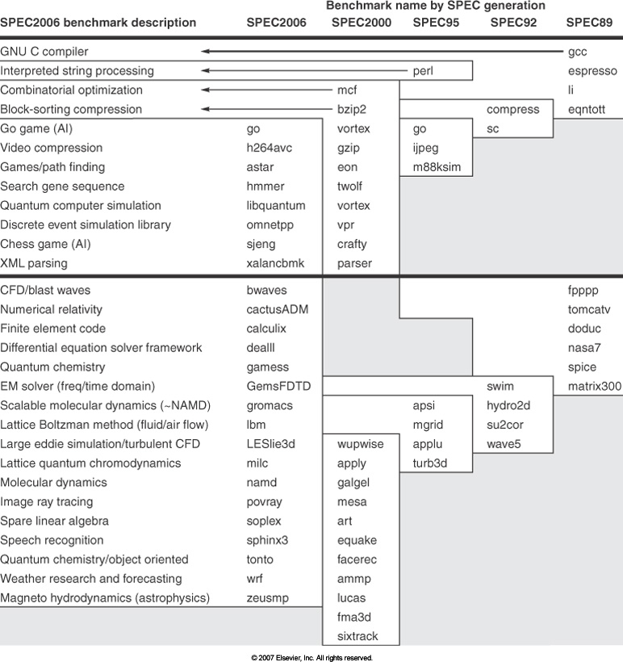
SPEC Benchmarks
Notes:
Why would we remove a benchmark of one type and add another of the same type?
What is horizontal thick line? (int / fp)

Slide 6
SPEC Discussion
From SPECx to SPECy, why would we remove a benchmark of one type and add a benchmark of the same type?
Can a particular problem be solved in more than one way? Example: Solving a system of equations.
Should a benchmark reflect “solve the problem using this particular algorithm” or “solve the problem using any algorithm”?

Slide 7
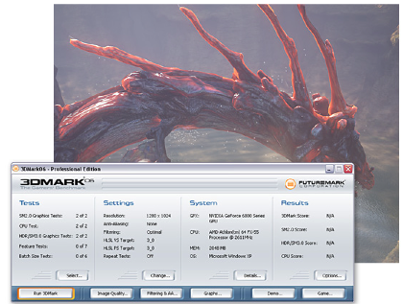
3DMark06 Benchmark
Historically, becomes more CPU-bound over time
Graphics (4) and CPU (2) benchmarks in 3DMark06
Notes:
3DMark06: A PC benchmark suite designed to test the DirectX9 performance of your graphics card.
A 3DMark score is an overall measure of your system's 3D gaming capabilities, based on comprehensive real-time 3D graphics and processor tests.

Slide 8
TPC-C Benchmark
“The difficulty in designing TPC benchmarks lies in reducing the diversity of operations found in a production application, while retaining its essential performance characteristics, namely, the level of system utilization and the complexity of its operations.”
Overview of the TPC Benchmark C:
The Order-Entry Benchmark
By Francois Raab, Walt Kohler, Amitabh Shah
Notes:
TPC: Transaction Processing Performance Council

Slide 9
TPC-C Overview
n Warehouses
Each warehouse, 10 sales districts, terminal per sales district
Each sales district, 3000 customers
New Order
10 items, 10% chance from another warehouse
Other Transactions
Payment, order status, delivery, stock query
TPC-C Measures
Orders per second (tpmC)
Price-performance ($/tpmC)

Slide 10
More Benchmark Suites … Really?
BabelStream, GPU-STREAM, STREAM
ECP Proxy Apps
FinanceBench
Hetero-Mark
Mantevo
NPB-OCL
OpenDwarfs
Pannotia
Parboil
Polybench
Rodinia
SHOC
ViennaCL
An Automated Framework for Characterizing and Subsetting GPGPU Workloads. V. Adhinarayanan, W. Feng. In Proc. of the IEEE Int’l Symp, on Performance Analysis of Systems and Software (ISPASS), Uppsala, Sweden, April 2016. Paper (PDF) Citations: [ BibTeX XML PlainText ]
Potential for
Many research artifacts that extend the above.
Many M.S. and even Ph.D. theses.

Slide 11
Outline
Benchmarks
Technology
In a power-constrained world, we can’t keep increasing performance by increasing clock speed.
Architectural Trends
Microarchitectures have historically increased performance by increasing ILP and pipeline depth. Today, we can’t keep increasing performance at historical levels by these methods.
Bandwidth vs. Latency

Slide 12
Technology
As technology improves, what gets faster/bigger/better?
Gate delay
Chip size
Number of pins
Pin bandwidth
Memory bandwidth
Memory latency

Slide 13
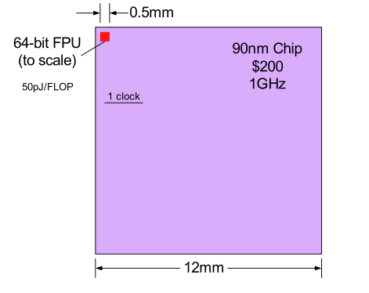
VLSI Capability (2011)
[Courtesy: Bill Dally]

Slide 14
Today’s VLSI Capability
1. Exploits Ample Computation!
[Courtesy: Bill Dally]

Slide 15
Today’s VLSI Capability
1. Exploits Ample Computation!
2. Requires Efficient Communication!
[Courtesy: Bill Dally]

Slide 16

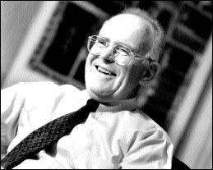
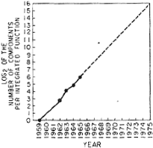
Moore’s Law
“The complexity for minimum component costs has increased at a rate of roughly a factor of two per year (see graph on next page). Certainly, over the short term this rate can be expected to continue, if not to increase. Over the longer term, the rate of increase is a bit more uncertain, although there is no reason to believe it will not remain nearly constant for at least 10 years. That means by 1975, the number of components per integrated circuit for minimum cost will be 65,000. I believe that such a large circuit can be built on a single wafer.”
“Cramming More Components onto Integrated Circuits” by Gordon E. Moore, Electronics, Vol. 38, No. 8, April 19, 1965.

Slide 17
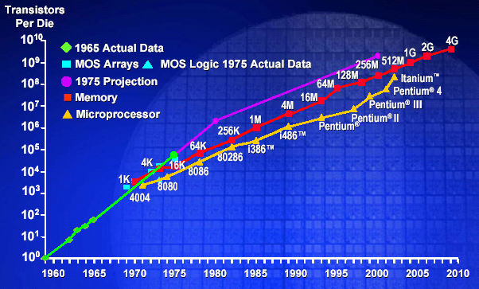
Intel Historical Data

Slide 18

Semiconductor Scaling Rates
From Digital Systems Engineering, Dally and Poulton, 1998
Parameter | Current Value | Yearly Factor | Years to Double (Half)
Moore’s Law (grids on a die)** | 1 B | 1.49 | 1.75
Gate Delay | 150 ps | 0.87 | (5)
Capability (grids / gate delay) |  | 1.71 | 1.3
Device-length wire delay |  | 1.00
Die-length wire delay / gate delay |  | 1.71 | 1.3
Pins per package | 750 | 1.11 | 7
Aggregate off-chip bandwidth |  | 1.28 | 3
** Ignores multi-layer metal, 8-layers in 2001
Notes:
Capability is product of Moore’s Law and gate delay. This is a very impressive rate of improvement.
Wire delay looks acceptable

Slide 19
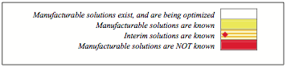
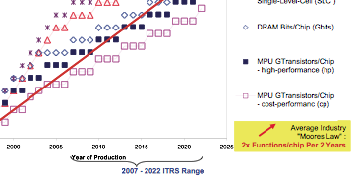
International Technology Roadmap for Semiconductors

Slide 20
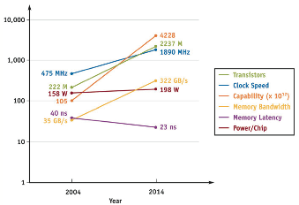
10-Year GPU Projection (2004–14)
Transistors (NV40):
222M/2237M
Clock speed (NV40, MHz): 475/1890
Capability: 105B/4228B
Memory bandwidth (NV40, GB/s): 35/322
Memory latency (RAS, ns): 40/23
Power/chip (maximum, W): 158/198 (then flat?)
Take-home point: Capability > mem bw > mem latency
Source: Owens, “Streaming Architectures and Technology Trends,” GPU Gems 2, March 2005.

Slide 21
Technology Theme
In a power-constrained world, we cannot keep increasing performance by increasing clock speed.

Slide 22
Process Generations
Let’s assume one process generation to the next makes new transistors 0.7 times the size of the old transistors (“linear shrink”)
Recent example: 65 nm to 45 nm = 0.692
What is this “feature size”?
How does this relate to Moore’s Law?
Notes:
Feature size = channel width of transistor

Slide 23
Historical Scaling (0.7x)
Power = C_{eff} [device] × # devices × voltage² × freq
Not talking about wires, leakage, etc.
With process shrink, assuming constant die size:
Change in C_{eff}:
Change in number of devices:
Change in frequency:
Plug that all together:
Notes:
Feature size = channel width of transistor

Slide 24
Historical Scaling (0.7x)
Power = C_{eff} [device] × # devices × voltage² × freq
Not talking about wires, leakage, etc.
With process shrink, assuming constant die size:
Change in C_{eff}: 0.7x
Change in number of devices: 1/(0.7 × 0.7) = 2x
Change in frequency: 1/0.7x = 1.4x
Plug that all together: 2x
Notes:
Feature size = channel width of transistor

Slide 25
Historical Scaling (0.7x)
Power = C_{eff} [device] × # devices × voltage² × freq
Not talking about wires, leakage, etc.
With process shrink:
Change in C_{eff}:
Change in number of devices:
Change in frequency:
What else do we need to change to get constant power?
Plug that all together:
Notes:
Feature size = channel width of transistor

Slide 26
Historical Scaling (0.7x)
Power = C_{eff} [device] × # devices × voltage² × freq
Not talking about wires, leakage, etc.
With process shrink:
Change in C_{eff}: 0.7x
Change in number of devices: 1/(0.7 × 0.7) = 2x
Change in frequency: 1/0.7x = 1.4x
Change in voltage squared: (0.7 × 0.7)x = 0.5x
Plug that all together: 1x (constant power draw)
Notes:
Feature size = channel width of transistor
While this held, smaller transistors ran faster, used less power, and cost less. But there was a limit to how long this would last.

Slide 27
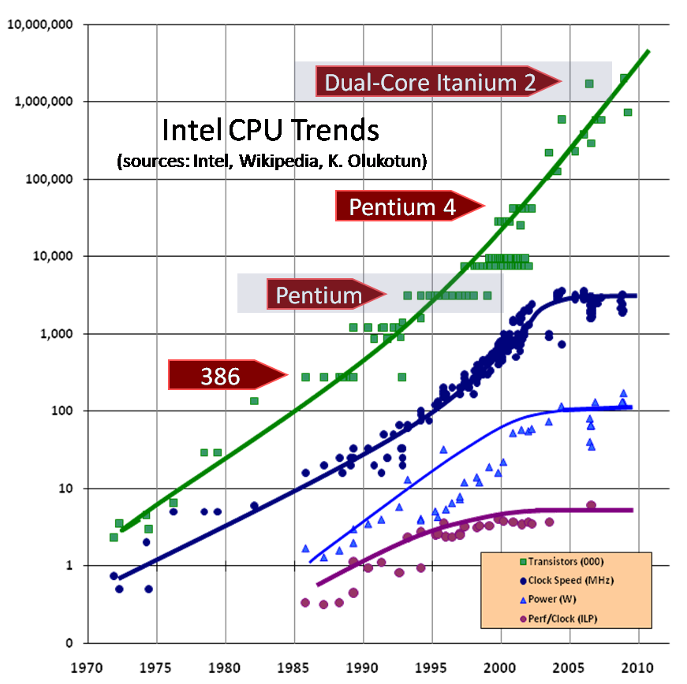
Historical Scaling Result
Constant power from generation to generation
What is our increase of (potential) performance from generation to generation?
2x devices × 1.4x frequency = 2.8x performance at same power
Dennard’s Law:
As the dimensions of a device go down, so does its power consumption.
Notes:
2x devices * 1.4x frequency = 2.8x performance at same power

Slide 28
Scaling by the Mid-2000s?
For 0.7x transistor scaling:
C_{eff} continues to scale (0.7x)
Device density continues to scale (2x)
Voltage does not scale as much (0.95x)
Frequency increases only by 1.2x
Result: 2.4x performance, 1.5x power
Dennard’s Law:
As the dimensions of a device go down, so does its power consumption.

Slide 29
Outline
Benchmarks
Technology
In a power-constrained world, we can’t keep increasing performance by increasing clock speed.
Architectural Trends
Microarchitectures have historically increased performance by increasing ILP and pipeline depth. Today, we can’t keep increasing performance at historical levels by these methods.
Bandwidth vs. Latency

Slide 30
Architectural Trends
Microarchitectures have historically increased performance by increasing ILP and pipeline depth.
We have not been able to continue increasing performance at these historical levels by these methods.

Slide 31
Why Do Processors Get Faster?
Define “faster” as “more instructions per second”
Neglecting software improvements …
3 reasons:
More parallelism (or more work per pipeline stage)
Fewer clocks/instruction
Deeper pipelines
Fewer gates/clock
Transistors get faster (Moore’s Law)
Fewer ps/gate

Slide 32
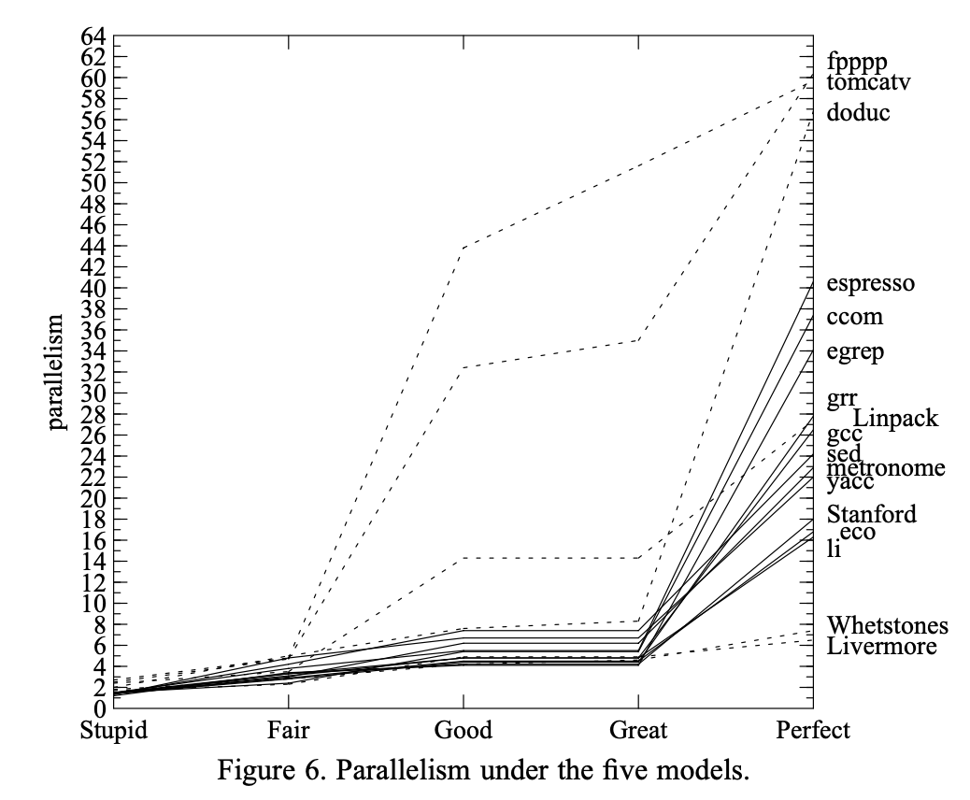
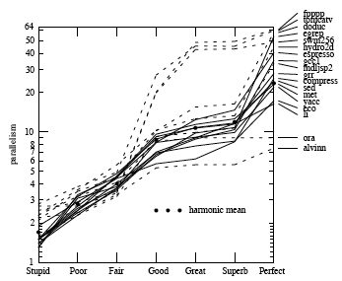
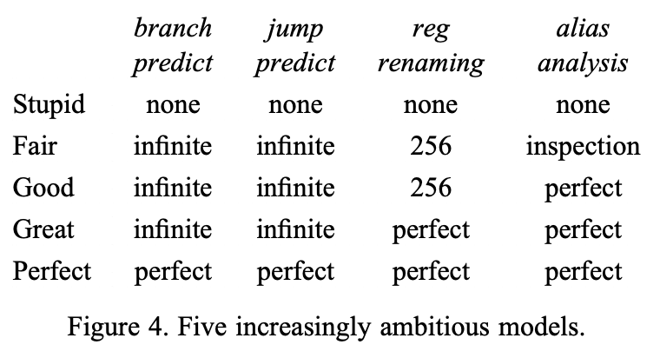
Limits to Instruction-Level Parallelism
[David Wall, Limits of Instruction-Level Parallelism, WRL Research Report 93/6]
Notes:
Growing interest in ambitious multiple-issue machines and heavily pipelined machines requires a careful examination of how much instruction-level parallelism exists in typical programs. Such an examination is complicated by the wide variety of hardware and software techniques for increasing the parallelism that can be exploited, including branch prediction, register renaming, and alias analysis.
Categories of ILP: (1) techniques for increasing the parallelism within a basic block and (2) techniques for using parallelism across several basic blocks.
Trace-driven simulation to study the importance of register renaming, branch and jump prediction, and alias analysis on a simulator (a la what we do with GEM5).
assumes branch prediction, jump prediction, register renaming, alias analysis, “generous default window size and cycle width”.
Stupid model rarely gets above 2
Lack of branch prediction means that it finds only intra-block parallelism. (In compiler construction, a basic block is a straight-line code sequence with no branches in except to the entry and no branches out except at the exit.)
Lack of renaming (to remove artificial dependencies due to register reuse) and alias analysis (remove false dependency) means it won’t find much of that.
The Fair model is better, with // between 2-4 common.
The Great model rarely has parallelism above 7 with 5 more common.
The Perfect model is intractable to reasonably achieve. Why?
* A study that assumed perfect branch prediction, perfect alias analysis, and perfect register renaming would lead us down a dangerous garden path. So would a study that included only fpppp and tomcatv, unless that’s really all we want to run on our machine.

Slide 33
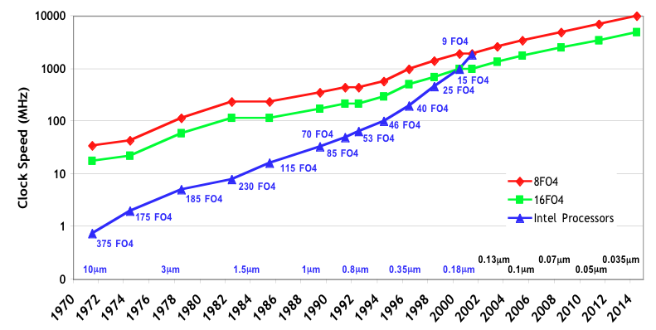
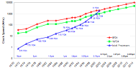
Clock Scaling: Historical & Projected
“The Optimal Logic Depth Per Pipeline Stage is 6 to 8 FO4 Inverter Delays” (ISCA02) [courtesy Steve Keckler]
Notes:
FO4 (i.e., fanout 4 inverter delay)
This graph illustrates clock rate increases resulting from a combination of faster transistors and deeper pipelines. The red and green lines illustrate the clock rate improvement that has resulted from faster transistors, assuming a constant pipeline depth (8 and 16 levels of logic respectively). These rates scale along with transistor dimensions at a rate of 19% per year.
The blue line consists of data collected from Intel microprocessors ranging from the 4004 in 1971 to the Pentium IV in 2001. The number of levels of logic per clock cycle has decreased by more than a factor of 30, but pipelining has reached its limits. Further clock rate improvements will at best be limited to improvements in transistor speed.
References:
http://www.pcguide.com/ref/cpu/fam/index.htm
http://www.intel.com/intel/intelis/museum/exhibit/hist_micro/hof/tspecs.htm
8086-486: http://www.pcguide.com/ref/cpu/fam/index.htm
486-PentiumIV: Microprocessor Report

Slide 34
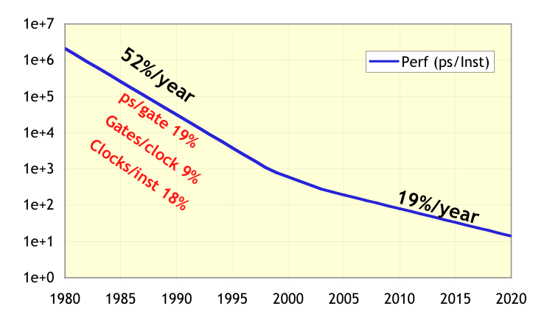
Microprocessor Scaling is Slowing
[courtesy of Bill Dally]
Notes:
Over the past 20 years (and in fact since the first microprocessor in 1971), microprocessor performance has been improving at a rate of approximately 52% per year. This exponential increase in performance has come from three sources: (1) improvements in clock rates from innovations in silicon processing technology that have made transistors smaller and faster – 19%/year, (2) improvements in clock rates resulting from deepening pipelines and reducing the number of levels of logic per clock – 9%, and (3) improvements in microarchitectures including multi-instruction issue and out-of-order execution – 18%. Modern designs have nearly exhausted the benefits of pipelining, and conventional architectures are struggling to sustain even one instruction per cycle. Without further innovations, performance improvements will at best only match the rate of improvement due to further process technology innovations, which is projected to continue at 19% per year.
This chart depicts this trend by graphing performance measured in picoseconds/instruction. Thus, improved performance is signified by a lower value in the chart. Note also that the y-axis is on a logarithmic scale.

Slide 35
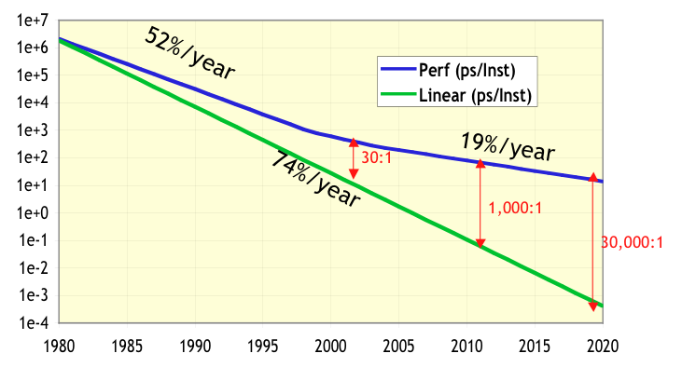
Future Potential is Large
At the right-hand turn: 30:1
5 years: 1000:1
[courtesy of Bill Dally]
Notes:
While microprocessors have sustained performance improvements of 52%/year, fabrication technology has actually provided a much higher growth rate in potential capability. When accounting for increased transistor counts and faster transistor switching speeds, the capability of microprocessor-scale integrated circuits has been improving at 74%/year. Until now, the differential between the 74% and 52% rates has resulted in only a factor of 30 of untapped performance potential. However, with only 19% per year projected in the future, the differential is expected to increase to a factor of 30,000 by 2020. This quantity represents a tremendous opportunity for novel architectures to help bridge the performance gap and to enable future computer systems to solve increasingly complex and important problems.

Slide 36
Summary
Microprocessors have historically increased performance by
Increasing clock speed
Increasing pipeline depth
Increasing instruction-level parallelism (work per clock)
We CANNOT continue improving performance by doing any of these things anymore.

Slide 37
Outline
Benchmarks
Technology
In a power-constrained world, we can’t keep increasing performance by increasing clock speed.
Architectural Trends
Microarchitectures have historically increased performance by increasing ILP and pipeline depth. Today, we can’t keep increasing performance at historical levels by these methods.
Bandwidth vs. Latency

Slide 38
Bandwidth vs. Latency

Slide 39
Technology Rates of …
Processor
Logic Capacity: ~30% per year
Clock Rate: ~20% per year (2003-2011);
~10% per year (2011-2015); ~3% per year (2015-now)
Memory
DRAM Capacity: ~60% per year (4x every 3 years)
Memory Speed: ~10% per year
Cost Per Bit: Improves ~25% per year
Disk
Capacity: ~60% per year
Total Use of Data: ~100% per 9 months!
Network
Bandwidth: 100%+ per year

Slide 40
Disk Trends
MapReduce is a programming model for processing vast amounts of data. One of the reasons that it works so well is because it exploits a sweet spot of modern disk drive technology trends. In essence MapReduce works by repeatedly sorting and merging data that is streamed to and from disk at the transfer rate of the disk. Contrast this to accessing data from a relational database that operates at the seek rate of the disk (seeking is the process of moving the disk's head to a particular place on the disk to read or write data).
So why is this interesting? Well, look at the trends in seek time and transfer rate. Seek time has grown at about 5% a year, whereas transfer rate at about 20%. Seek time is growing more slowly than transfer rate—so it pays to use a model that operates at the transfer rate, which is what MapReduce does.
http://www.lexemetech.com/2008/03/disks-have-become-tapes.html

Slide 41
Disk Trends
The general point summed up by Jim Gray in an interview in ACM Queue from 2003:
... programmers have to start thinking of the disk as a sequential device rather than a random access device.
Or the more pithy …
“Disks have become tapes.” (Quoted by David DeWitt.)
http://www.lexemetech.com/2008/03/disks-have-become-tapes.html

Slide 42
Tracking Technology: Performance Trends
Drill down on four technologies
Disks; Memory; Network; Processors
~1980 Archaic (Nostalgic) vs. ~2000 Modern (Newer)
Performance milestones in each technology
Compare “Bandwidth vs. Latency” improvements in performance over time
Define
Bandwidth: number of events per unit time
e.g., Mbits / second over network, MB / second from disk
Latency: elapsed time for a single event
e.g., one-way network delay in microseconds, average disk access time in milliseconds
D. Patterson, “Latency Lags Bandwidth,” Communications of the ACM, October 2014

Slide 43
Disks Archaic (Nostalgic) vs. Modern (Newer)
CDC Wren I, 1983
3600 RPM
0.03 GBytes capacity
Tracks/Inch: 800
Bits/Inch: 9550
Three 5.25” platters
Bandwidth: 0.6 MBytes/sec
Latency: 48.3 ms
Cache: none
Seagate 373453, 2003
15000 RPM (4X)
73.4 GBytes (2500X)
Tracks/Inch: 64000 (80X)
Bits/Inch: 533,000 (60X)
Four 2.5” platters
(in 3.5” form factor)
BW: 86 MB/sec (140X)
Latency: 5.7 ms (8X)
Cache: 8 MB
D. Patterson, “Latency Lags Bandwidth,” Communications of the ACM, October 2014

Slide 44
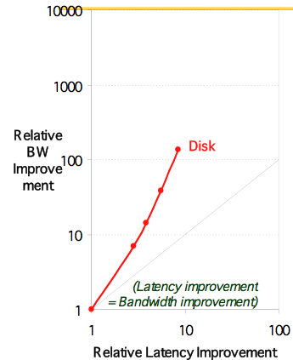
Disk Latency vs. Bandwidth
Disk: 3600, 5400, 7200, 10000, 15000 RPM (8x, 143x)
latency = simple operation w/o contention
bandwidth (BW) = best case
D. Patterson, “Latency Lags Bandwidth,” Communications of the ACM, October 2014
Notes:
Disk: 33X BW, 6X latency

Slide 45
Memory: Archaic (Nostalgic) vs. Modern (Newer)
1980 DRAM (asynchronous)
0.06 Mbits/chip
64,000 xtors, 35 mm²
16b data bus/module, 16 pins/chip
13 Mbytes/sec
Latency: 225 ns
(No block transfer)
2000 Double Data Rate Synchr. (clocked) DRAM
256 Mb/chip (4000X)
256M xtors, 204 mm²
64b data bus / DIMM, 66 pins/chip (4X)
1600 MB/sec (120X)
Latency: 52 ns (4X)
Block transfers (page mode)
D. Patterson, “Latency Lags Bandwidth,” Communications of the ACM, October 2014

Slide 46
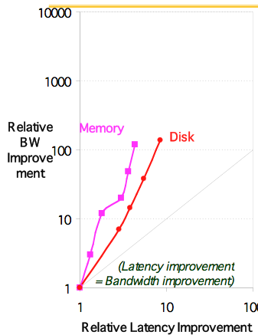
Latency Lags Bandwidth (last ~20 years)
Memory Module: 16-bit plain DRAM, Page Mode DRAM, 32b, 64b, SDRAM, DDR SDRAM (4x,120x)
latency = simple operation w/o contention
bandwidth (BW) = best case
D. Patterson, “Latency Lags Bandwidth,” Communications of the ACM, October 2014
Notes:
DRAM: 120X BW, 4X latency
Jog between 3rd and 4th point is because a lot of time between 32b Fast page mode and 64b

Slide 47
LANs Archaic (Nostalgic) vs. Modern (Newer)
Ethernet 802.3 (1978)
10 Mbits/s link speed
Latency: 3000 μsec
Shared media
Coaxial cable
Ethernet 802.3ae (2003)
10,000 Mbits/s (1000X) link speed
Latency: 190 μsec (15X)
Switched media
Category 5 copper wire
“Cat 5” is four twisted pairs in a bundle
Plastic Covering
Braided outer conductor
Twisted Pair:
Insulator
Copper core
Copper, 1mm thick, twisted to avoid antenna effect
D. Patterson, “Latency Lags Bandwidth,” Communications of the ACM, October 2014

Slide 48
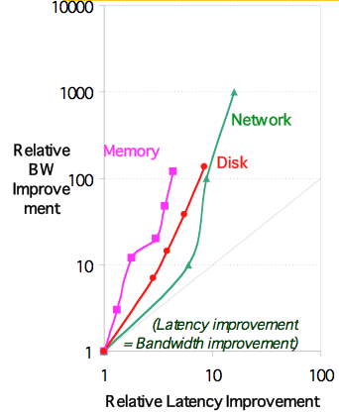
Latency Lags Bandwidth (last ~20 years)
Ethernet: 10Mb, 100Mb, 1000Mb, 10000 Mb/s (16x,1000x)
latency = simple operation w/o contention
bandwidth (BW) = best case
D. Patterson, “Latency Lags Bandwidth,” Communications of the ACM, October 2014.
Notes:
Network: 1000X BW, 13X Latency

Slide 49
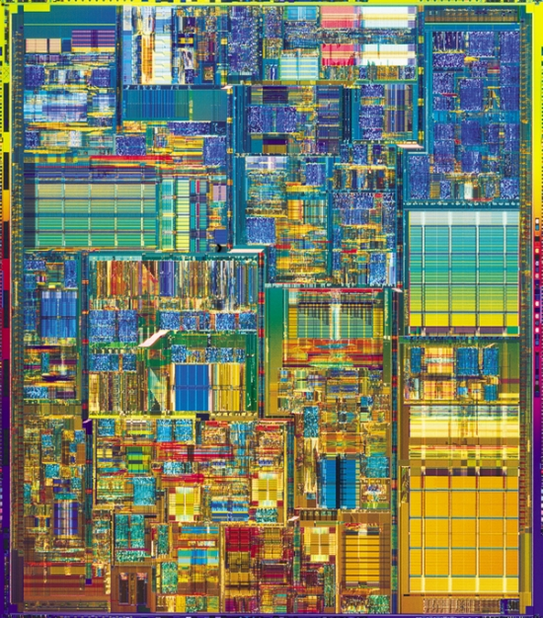
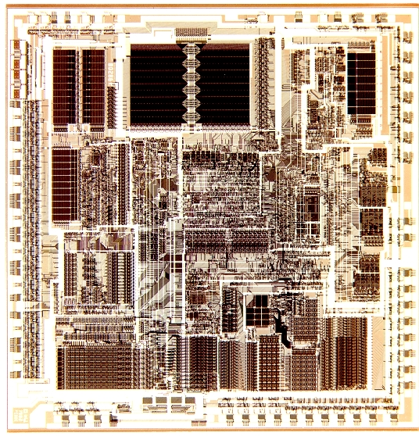
CPUs Archaic (Nostalgic) v. Modern (Newer)
1982 Intel 80286
12.5 MHz
2 MIPS (peak)
Latency 320 ns
134,000 xtors, 47 mm²
16-bit data bus, 68 pins
Microcode interpreter, separate FPU chip
(no caches)
2001 Intel Pentium 4
1500 MHz (120X)
4500 MIPS (peak) (2250X)
Latency 15 ns (20X)
42,000,000 xtors, 217 mm²
64-bit data bus, 423 pins
3-way superscalar, dynamic translate to RISC, superpipelined (22 stages), out-of-order execution
On-chip 8 KB data caches, 96 KB instr. trace cache, 256 KB L2 cache
Notes:
Would be nice to have a comparison and contrast of IBM chip from 80s and one from the 00s or 10s.

Slide 50
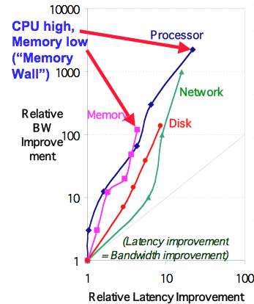
Latency Lags Bandwidth (last ~20 years)
Processor: ‘286, ‘386, ‘486, Pentium, Pentium Pro, Pentium 4 (21x,2250x)
D. Patterson, “Latency Lags Bandwidth,” Communications of the ACM, October 2014
Notes:
Processor: 2250X, 22X Latency

Slide 51
Latency Lags Bandwidth
RULE OF THUMB
In the time that bandwidth doubles, latency improves by no more than a factor of 1.2 to 1.4
… and capacity improves faster than bandwidth
Stated alternatively
Bandwidth improves by more than the square of the improvement in latency
D. Patterson, “Latency Lags Bandwidth,” Communications of the ACM, October 2014

Slide 52
6 Reasons Latency Lags BW
Moore’s Law helps BW more than latency
Faster transistors, more transistors, more pins help bandwidth
MPU Transistors: 0.130 vs. 42 M xtors (300X)
DRAM Transistors: 0.064 vs. 256 M xtors (4000X)
MPU Pins: 68 vs. 423 pins (6X)
DRAM Pins: 16 vs. 66 pins (4X)
D. Patterson, “Latency Lags Bandwidth,” Communications of the ACM, October 2014.

Slide 53
6 Reasons Latency Lags BW
Moore’s Law helps BW more than latency
Smaller, faster transistors but communicate over (relatively) longer lines: limits latency improvements
Feature size: 1.5 to 3 vs. 0.18 micron (8X,17X)
MPU Die Size: 35 vs. 204 mm² (ratio sqrt ⇒ 2X)
DRAM Die Size: 47 vs. 217 mm² (ratio sqrt ⇒ 2X)
D. Patterson, “Latency Lags Bandwidth,” Communications of the ACM, October 2014.

Slide 54
6 Reasons Latency Lags BW
Distance limits latency
Size of DRAM block ⇒ long bit and word lines ⇒ most of DRAM access time
Speed of light and computers on network
1. & 2. explains linear latency vs. square BW?
D. Patterson, “Latency Lags Bandwidth,” Communications of the ACM, October 2014.

Slide 55
6 Reasons Latency Lags BW
Bandwidth easier to sell (“bigger = better”)
Example
10 Gbits/s Ethernet (“10 Gig”) vs. 10 μsec latency Ethernet
4400 MB/s DIMM (“PC4400”) vs. 50 ns latency
Even if just marketing, customers now trained
Since bandwidth sells, more resources thrown at bandwidth, which further tips the balance
D. Patterson, “Latency Lags Bandwidth,” Communications of the ACM, October 2014.

Slide 56
6 Reasons Latency Lags BW
Latency helps BW, but not vice versa
Spinning disk faster improves both bandwidth and rotational latency
3600 RPM ⇒ 15000 RPM = 4.2X
Average rotational latency: 8.3 ms ⇒ 2.0 ms
Things being equal, also helps BW by 4.2X
Lower DRAM latency ⇒ More access/second (higher bandwidth)
Higher linear density helps disk BW (and capacity), but not disk latency
9,550 BPI ⇒ 533,000 BPI ⇒ 60X in BW
D. Patterson, “Latency Lags Bandwidth,” Communications of the ACM, October 2014.

Slide 57
6 Reasons Latency Lags BW
Bandwidth hurts latency
Queues help bandwidth, hurt latency (Queuing Theory)
Adding chips to widen a memory module increases bandwidth but higher fan-out on address lines may increase latency
Operating system overhead hurts latency more than bandwidth
Long messages amortize overhead; overhead bigger part of short messages
D. Patterson, “Latency Lags Bandwidth,” Communications of the ACM, October 2014.

Slide 58
Summary of Technology Trends
For disk, LAN, memory, and microprocessor, bandwidth improves by square of latency improvement
In the time that bandwidth doubles, latency improves by no more than 1.2X to 1.4X
Lag probably even larger in real systems, as bandwidth gains multiplied by replicated components
Multiple processors in a cluster or even in a chip
Multiple disks in a disk array
Multiple memory modules in a large memory
Simultaneous communication in switched LAN
HW and SW developers should innovate assuming “Latency Lags Bandwidth”
If everything improves at the same rate, then nothing really changes. When rates vary, require real innovation
Notes:
CACHING REPLICATION PREDICTION

